Slide 1

Point Cloud Processing
With Python and Open3D
By: Team Whileloop

Slide 2
Team Members:
Ashwin R - 19BAI10132 ashwin.r2019@vitbhopal.ac.in Aishwarya Mudaliar - 19BAI10182 AISHWARYA.MUDALIAR2019@vitbhopal.ac.in Sandal Agrawal - 19BAI10193 sandal.agrawal201@vitbhopal.ac.in

Slide 3
Idea behind Point Cloud
As the world’s gone digital, so too has technology, being used ever more in construction and planning projects. 3D images representing real-world objects, landscapes and spaces are being generated by software and displayed digitally. But for these images to be created, we first need to be able to read and identify their dimensions.

Slide 4
Point Cloud
Point clouds are datasets that represent objects or space. These points represent the X, Y, and Z geometric coordinates of a single point on an underlying sampled surface. Point clouds are a means of collating a large number of single spatial measurements into a dataset that can then represent a whole.

Slide 5
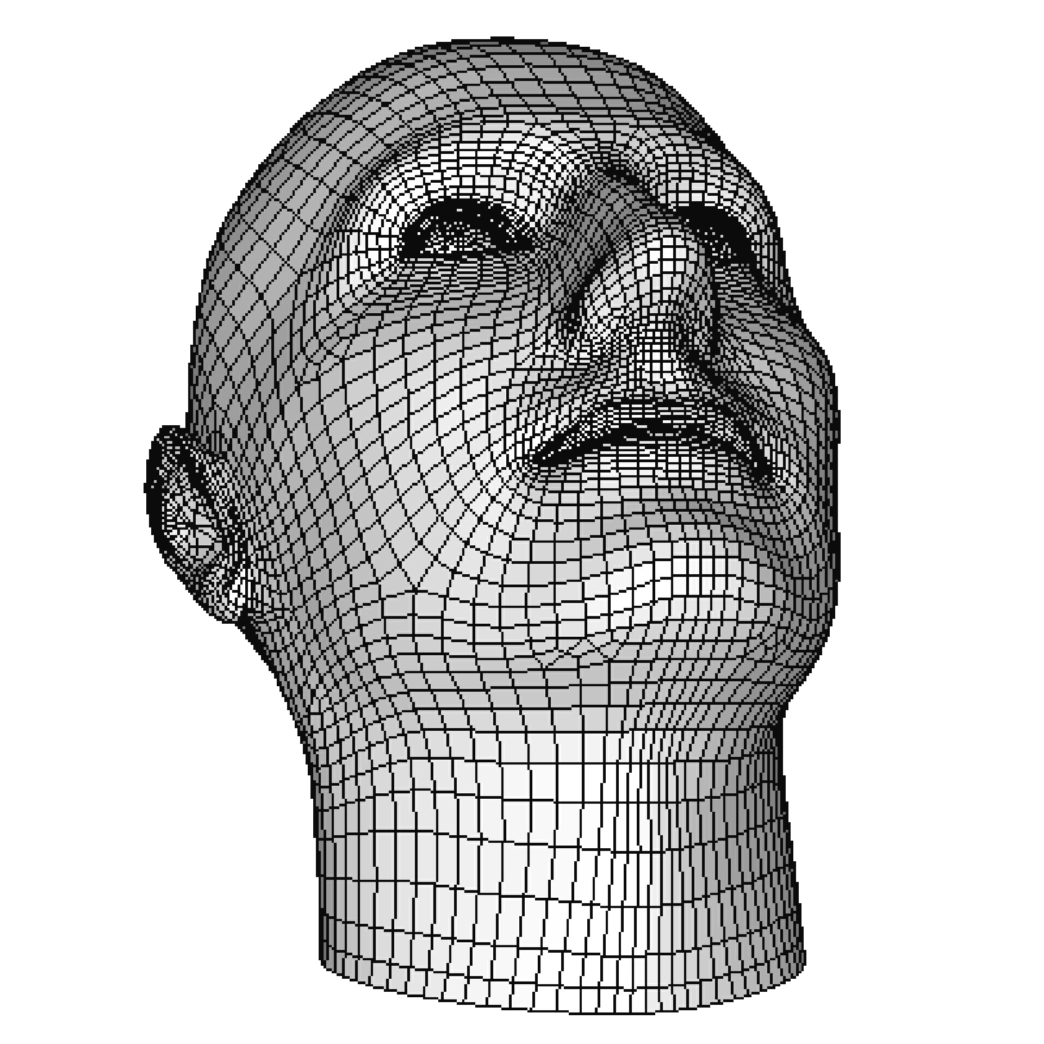
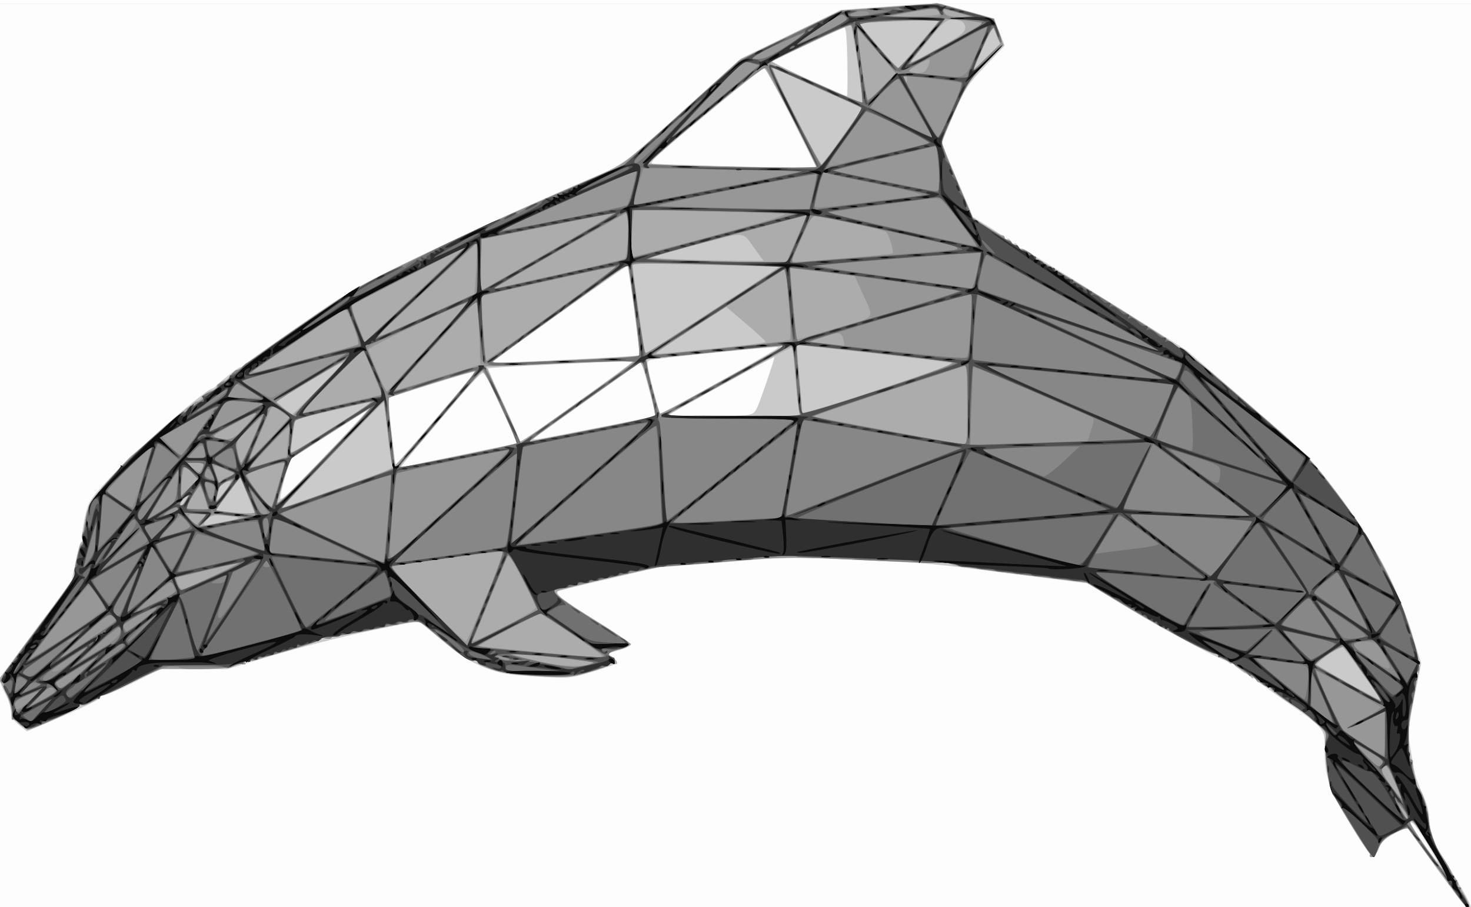
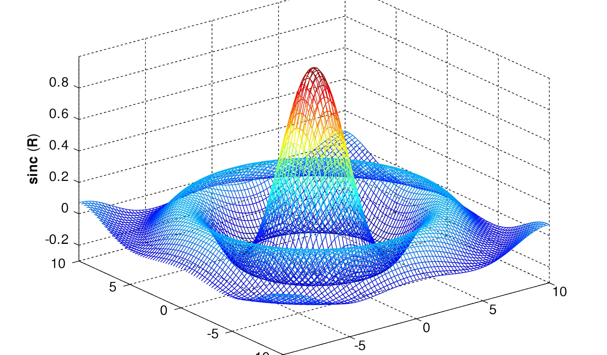
3D Mesh
A 3D mesh is the structural build of a 3D model consisting of polygons. 3D meshes use reference points in X, Y and Z axes to define shapes with height, width and depth.

Slide 6
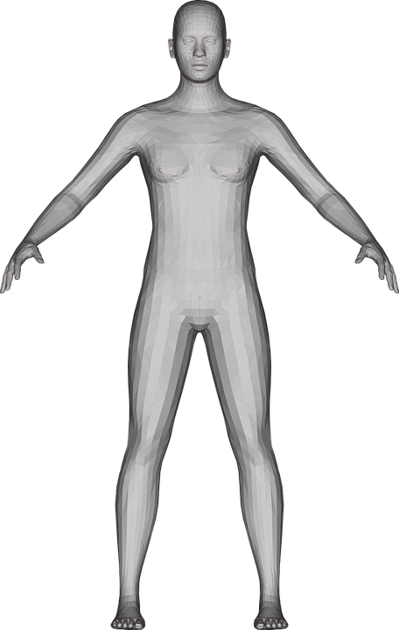
Algorithms in Point Cloud
There are 2 important algorithms in point cloud processing -
Ball-Pivot Algorithm
Poisson Reconstruction

Slide 7
Ball-Pivoting Algorithm (BPA)
It is a type of an algorithm, where we let a "ball" which is dependent on the scale of the mesh and also larger than the average of 2 points in the mesh to find the point cloud from the particular mesh.
When the ball is rolling, it will eventually get "stuck" upon 3 points which results in the formation of a "Seed Triangle". From that location, the ball rolls along the triangle edge formed from two points. The ball then settles in a new location: a new triangle is formed from two of the previous vertices and one new triangle is added to the mesh. As we continue rolling and pivoting the ball, new triangles are formed and added to the mesh. The ball continues rolling and rolling until the mesh is fully formed.
The values of the variables like Radius of the ball and Average distances between the points are based on the size and scale of the input point cloud. Here, the smaller the Radius of the ball, more triangles, which results in more detailed mesh. Keep in mind that the number of the triangles in a mesh is directly proportional to the model's depth, clarity and definition. Be aware that it will increase the computational time and CPU usage.

Slide 8
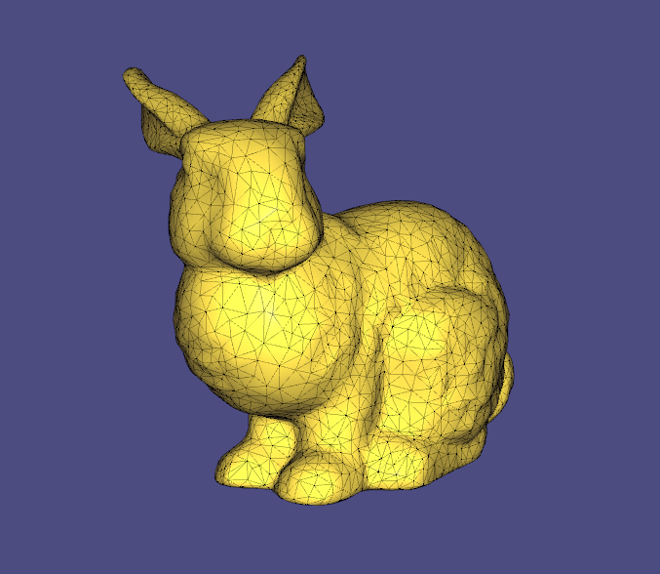
Poisson Reconstruction
The Poisson Reconstruction is a bit more mathematical as it involves computation of the implicit function along with the reconstruction of the surface based on the CGAL library's function Delaunay Refinement. Its approach is known as an implicit meshing method. To put it in simpler terms, we take a smooth cloth material and put it on the mesh which results in the watertight model.

Slide 9
Steps to run the Notebook:
There is a link which is called as Sampled Point Cloud Link, click it to download the sampled point cloud data.
Clone the repository or download it as a .zip file and extract it to run the Jupyter Notebook.
Specify the location of the downloaded file and the output path as well.
Make sure you install Open3D and NumPy modules before you run the Notebook.
Note: Open3D works only with Python 3.7.7 and below.

Slide 10
Thank you!
Happy Coding!!
From: Team Whileloop

